Slide 1
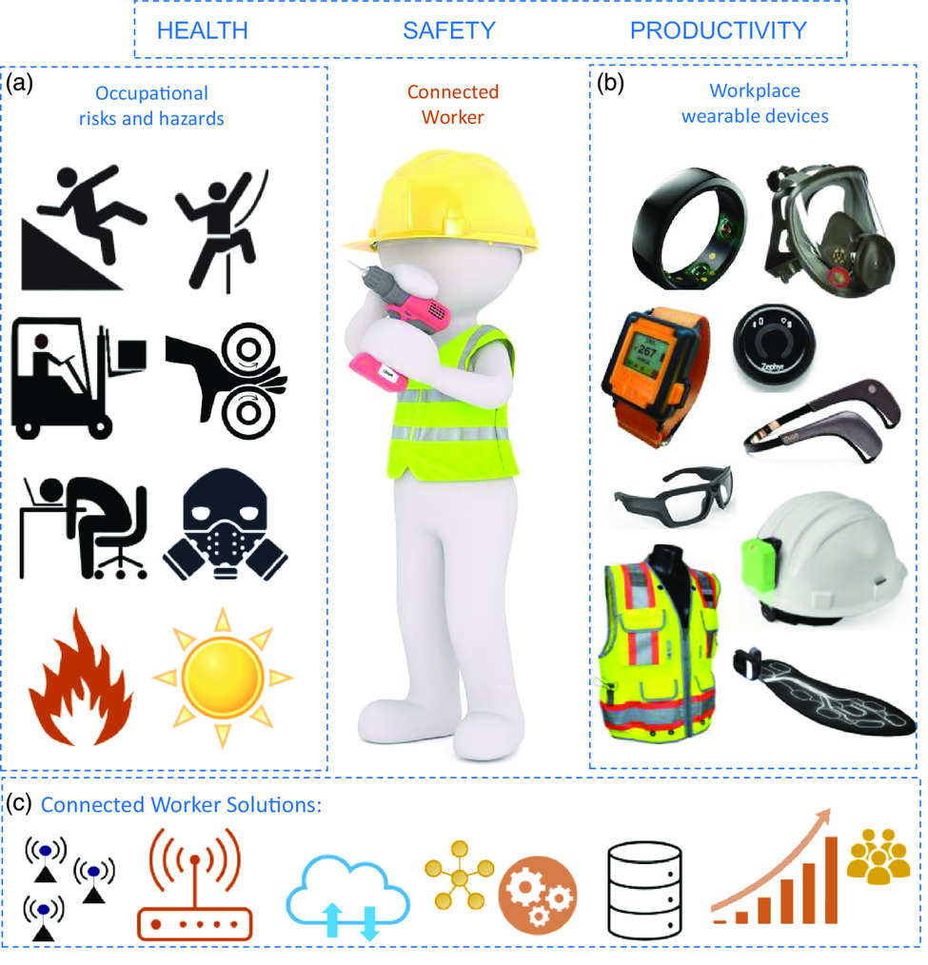
Trends in Workplace Wearable Technologies and Connected‐Worker Solutions for Next‐Generation Occupational Safety, Health, and Productivity
FIGURE 1: Overview of the three topics covered in this review: occupational risks and hazards, workplace wearables, and connected worker solutions. Occupational risks and hazards come from various sources and can adversely affect the workers’ safety, productivity, and health. Workplace wearables are smart devices worn on the body as accessories or garments to collect data on physiological and environmental conditions. Connected worker solutions engage the workplace wearables to a centralized hub for data storage, management, analytics, visualization, security, and actions. The vector icons on occupational risks and hazards are reproduced (adapted) with permission from the OSHA website on “Top 10 Most Frequently Cited Standards for Fiscal Year 2020”.[16]
Advanced Intelligent Systems, Volume: 4, Issue: 1, First published: 23 September 2021, DOI: (10.1002/aisy.202100099)
Notes:
Overview of the three topics covered in this review: occupational risks and hazards, workplace wearables, and connected worker solutions. Occupational risks and hazards come from various sources and can adversely affect the workers’ safety, productivity, and health. Workplace wearables are smart devices worn on the body as accessories or garments to collect data on physiological and environmental conditions. Connected worker solutions engage the workplace wearables to a centralized hub for data storage, management, analytics, visualization, security, and actions. The vector icons on occupational risks and hazards are reproduced (adapted) with permission from the OSHA website on “Top 10 Most Frequently Cited Standards for Fiscal Year 2020”.[16] The product images in (b) are reproduced with permission: smart ring:[229] Copyright 2021, Oura; full face respirator:[63] Copyright 2021, 3M; smart watch:[62] Copyright 2021, Reactec; chest device:[81] Copyright 2021, Zephyr; headband:[114] Copyright 2021, Muse; smart glasses:[231] Copyright 2021, ViewPoint System; smart PPE vest:[63] Copyright 2021, 3M; smart helmet:[61] Copyright 2021, Triax; and smart shoe insoles:[67] Copyright 2021, Arion.
IF THIS IMAGE HAS BEEN PROVIDED BY OR IS OWNED BY A THIRD PARTY, AS INDICATED IN THE CAPTION LINE, THEN FURTHER PERMISSION MAY BE NEEDED BEFORE ANY FURTHER USE. PLEASE CONTACT WILEY'S PERMISSIONS DEPARTMENT ON PERMISSIONS@WILEY.COM OR USE THE RIGHTSLINK SERVICE BY CLICKING ON THE 'REQUEST PERMISSIONS' LINK ACCOMPANYING THIS ARTICLE. WILEY OR AUTHOR OWNED IMAGES MAY BE USED FOR NON-COMMERCIAL PURPOSES, SUBJECT TO PROPER CITATION OF THE ARTICLE, AUTHOR, AND PUBLISHER.

